Slide 1
Genetic Diversity and Evolutionary Dynamics of Anopheles stephensi Populations in Selected West African Countries
Ayomikun Aderounmu

Slide 2
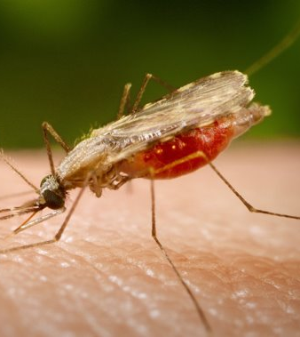
Anopheles stephensi
A critical vector in malaria transmission.
Insecticide resistance.
Adaption to different ecological niches.
Notes:
Implicated in multiple malaria outbreaks beginning from 2013, in Djibouti city and Dire Dawa in 2022
one of the major challenges in malaria control is the development of insecticidal resistance in Anopheles mosquitoes. The vector is resistant to pyrethroid-, organophosphate- and carbamate-based insecticides in Ethiopia
Artificial water storage tanks for breeding
This emerging field seeks to unravel how our evolutionary history has shaped our health, our interactions with diseases, and even the effectiveness of disease control methods. It's a multidisciplinary approach that draws on genetics, ecology, and epidemiology, among other fields, to explore these connections.
So, let's embark on this journey to understand how the genetics of Anopheles stephensi and the concept of evolutionary medicine are intertwined in the context of insecticidal resistance.

Slide 3
Biological Questions
What genomic differences can be observed in Anopheles stephensi populations across these selected locations.
What insights can comparative genomic analysis provide into the evolutionary history and population dynamics of Anopheles stephensi in these locations?
Are there any genomic markers associated with insecticide resistance or other adaptive traits in Anopheles stephensi populations across these locations?

Slide 4
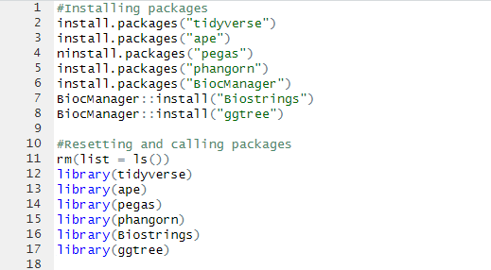

Installing and loading packages in R

Slide 5
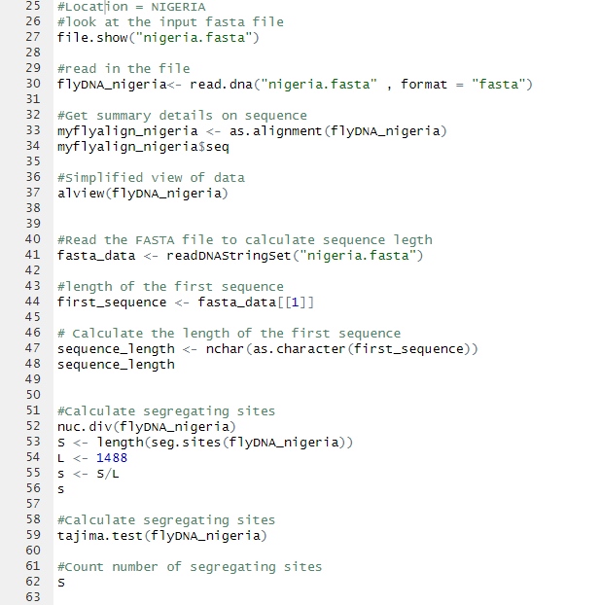
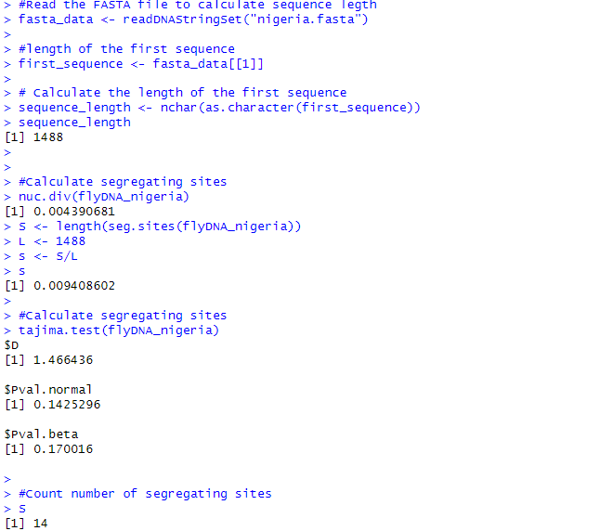
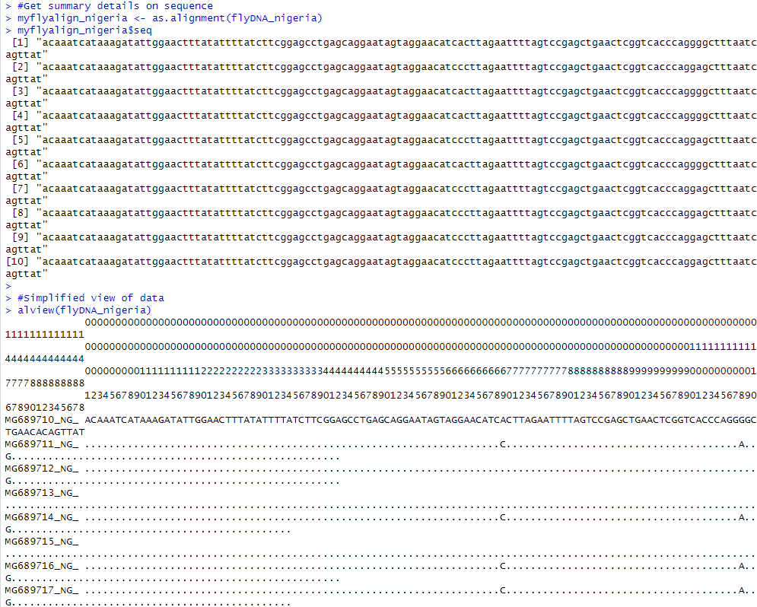
Analysis of An. stephensi from Nigeria

Slide 6
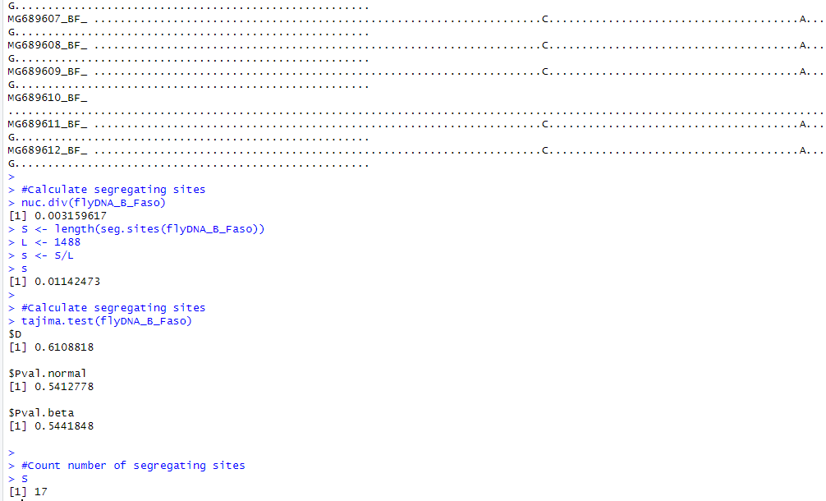
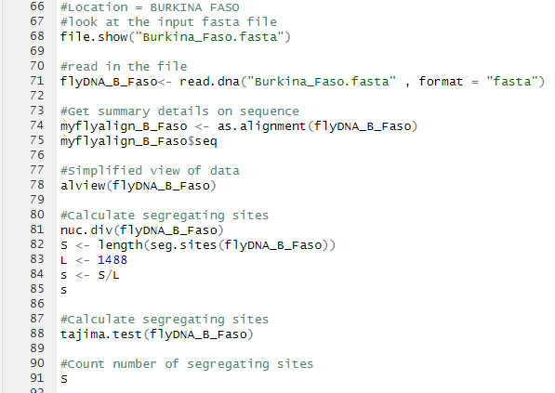
Analysis of An. stephensi from Burkina Faso

Slide 7
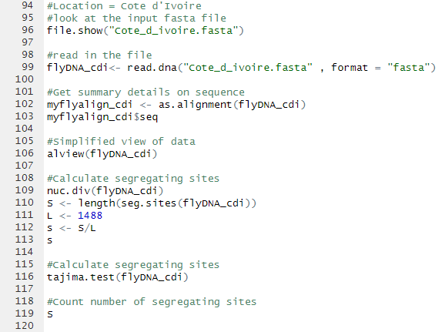
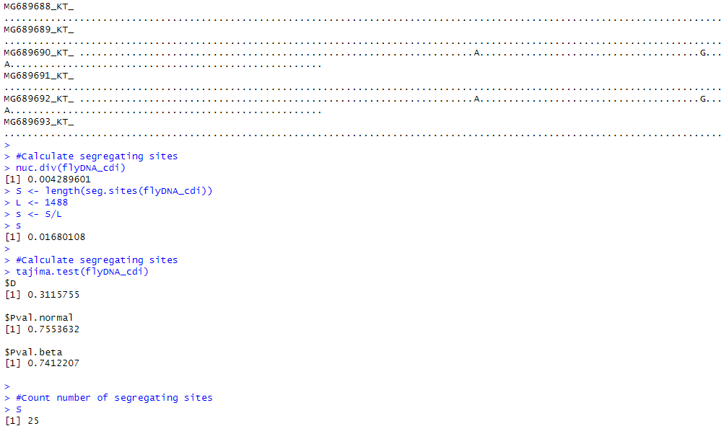
Analysis of An. stephensi from Cote d’Ivoire

Slide 8
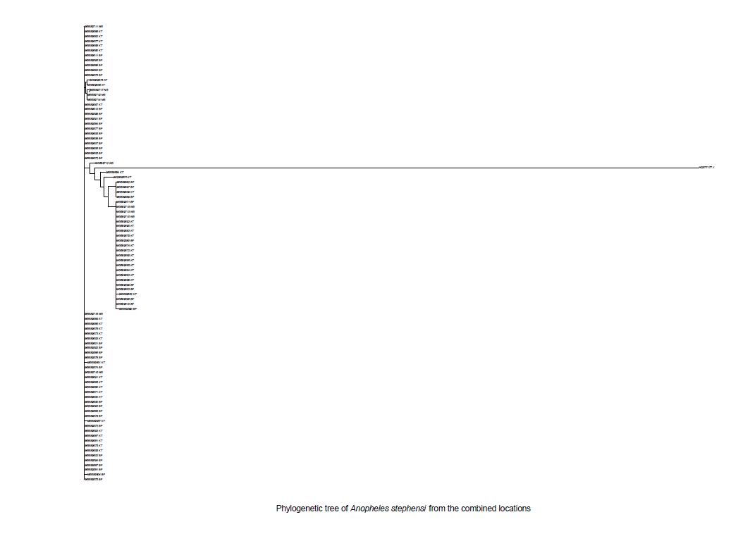
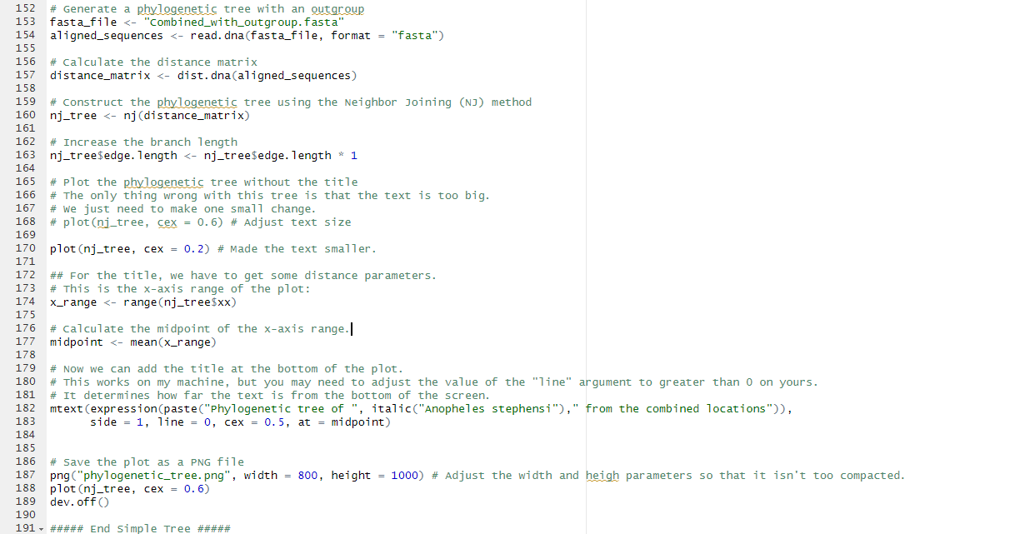
Phylogenetic analysis of the combined Locations

Slide 9
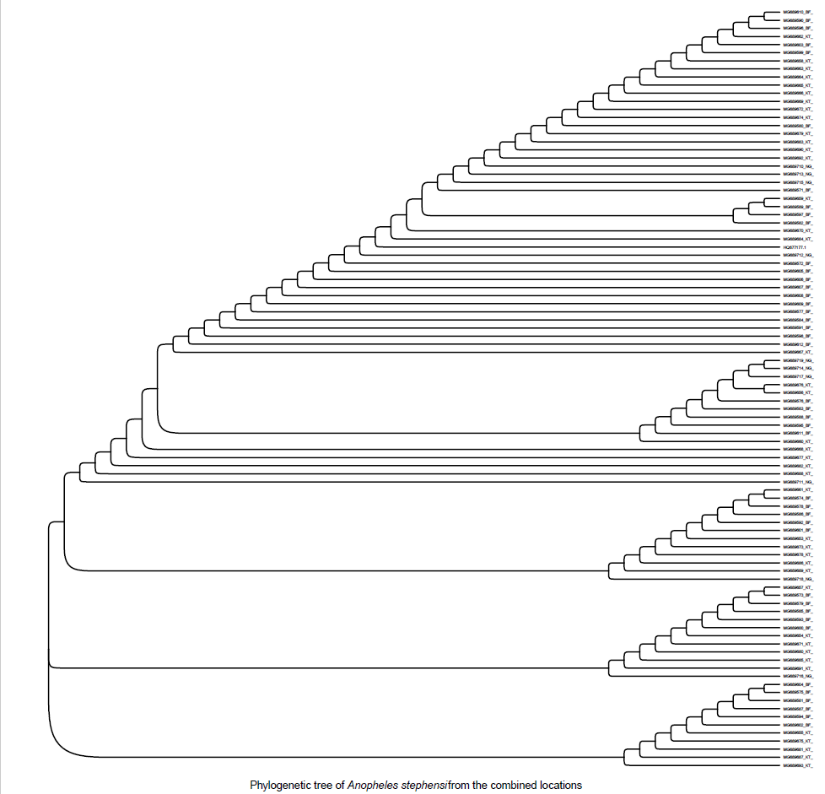
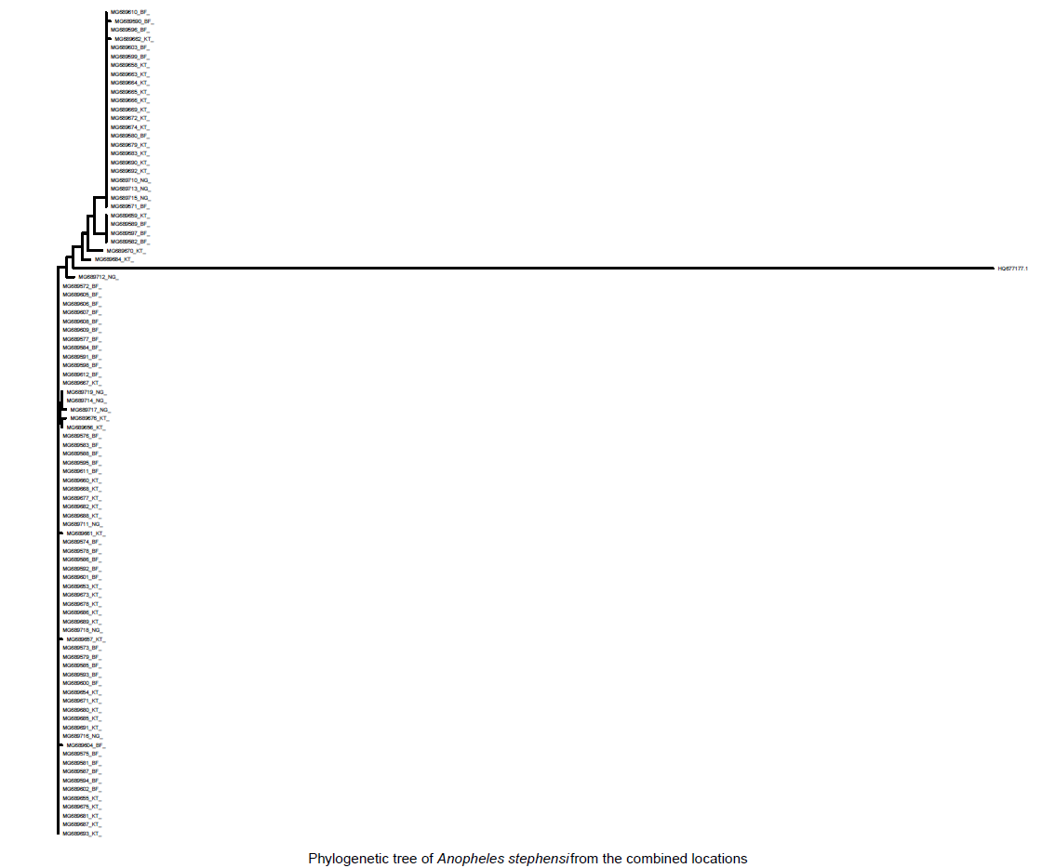
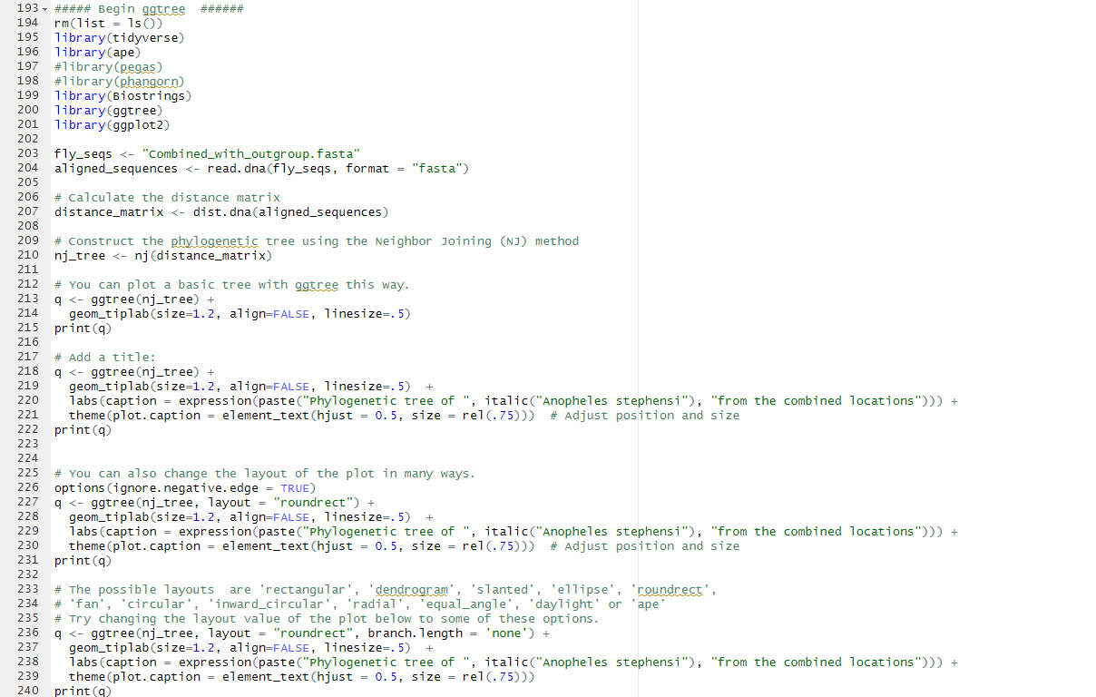
Phylogenetic analysis cont’d

Slide 10
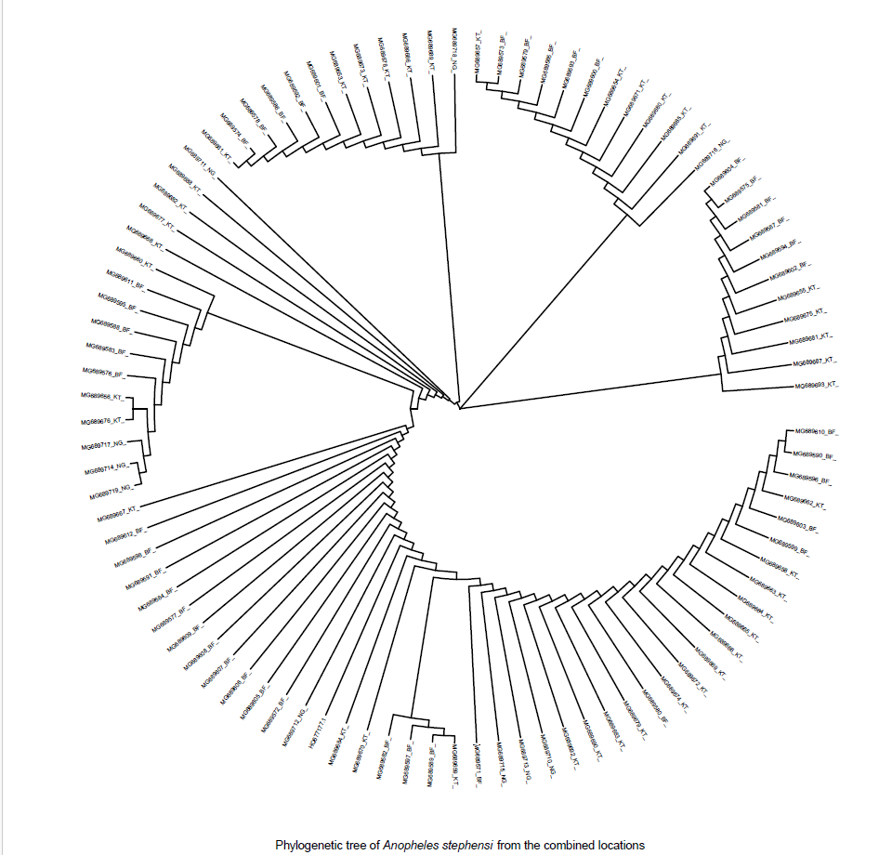
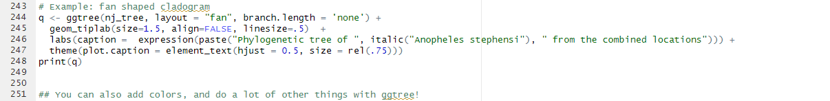
Phylogenetic analysis cont’d

Slide 11

QUESTIONS

